Slide 1
Final Monthly Forecast: April
By: Deepak Vanjani

Slide 2
April Forecast
Unemployment Rate: 3.79%
Nonfarm Payrolls Employment Growth: 170K

Slide 3
Method: Equal-Weighted Average of the Most Reliable Models
Explored baseline methods, determined which methods were the most reliable using RMSE & diagnostics, checked expert forecasts, and averaged forecasts
Reasons:
Minimizes risk
Reduces chance of over fitting, since the procedure isn’t dependent on data
If forecasts have low bias, the increase in precision improves square loss risk
If all methods are performing similarly, it allows all methods to contribute to the forecast

Slide 4
Previous Forecasts
Month | Actual | UNRATE Forecast | Method
January | 4.0% | 3.7% | Expert
February | 3.8% | 3.95% | Equal-weighted Average (Less Selective)
March | 3.8% | 3.8% | Equal-weighted Average (More Selective)
Month | Actual | PAYEMS Forecast | Method
January | 304K | 170K | Expert
February | 20K | 200K | Equal-weighted Average (Less Selective)
March | 196K | 155K | Equal-weighted Average (More Selective)

Slide 5
Baseline Methods Explored
AR(1 – 5) by ERM with respect to square loss
VAR(1 – 5) by minimizing additive square loss
VAR(5) by Penalized ERM: 4 different penalties
Bayesian: AR(6) with Laplace priors, mean = 0, default scale set by stan_glm
Machine Learning Methods: Tree, Random Forrest, Boosting

Slide 6
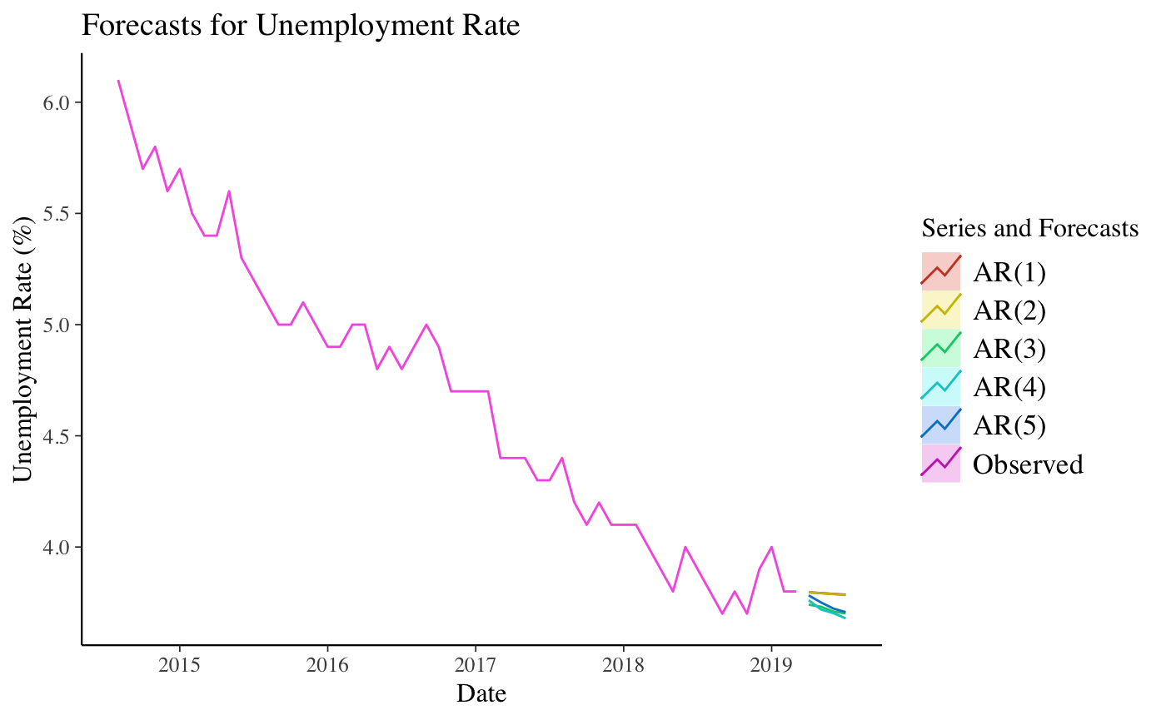
AR(1 – 5) by ERM with respect to Square Loss – Unrate

Slide 7
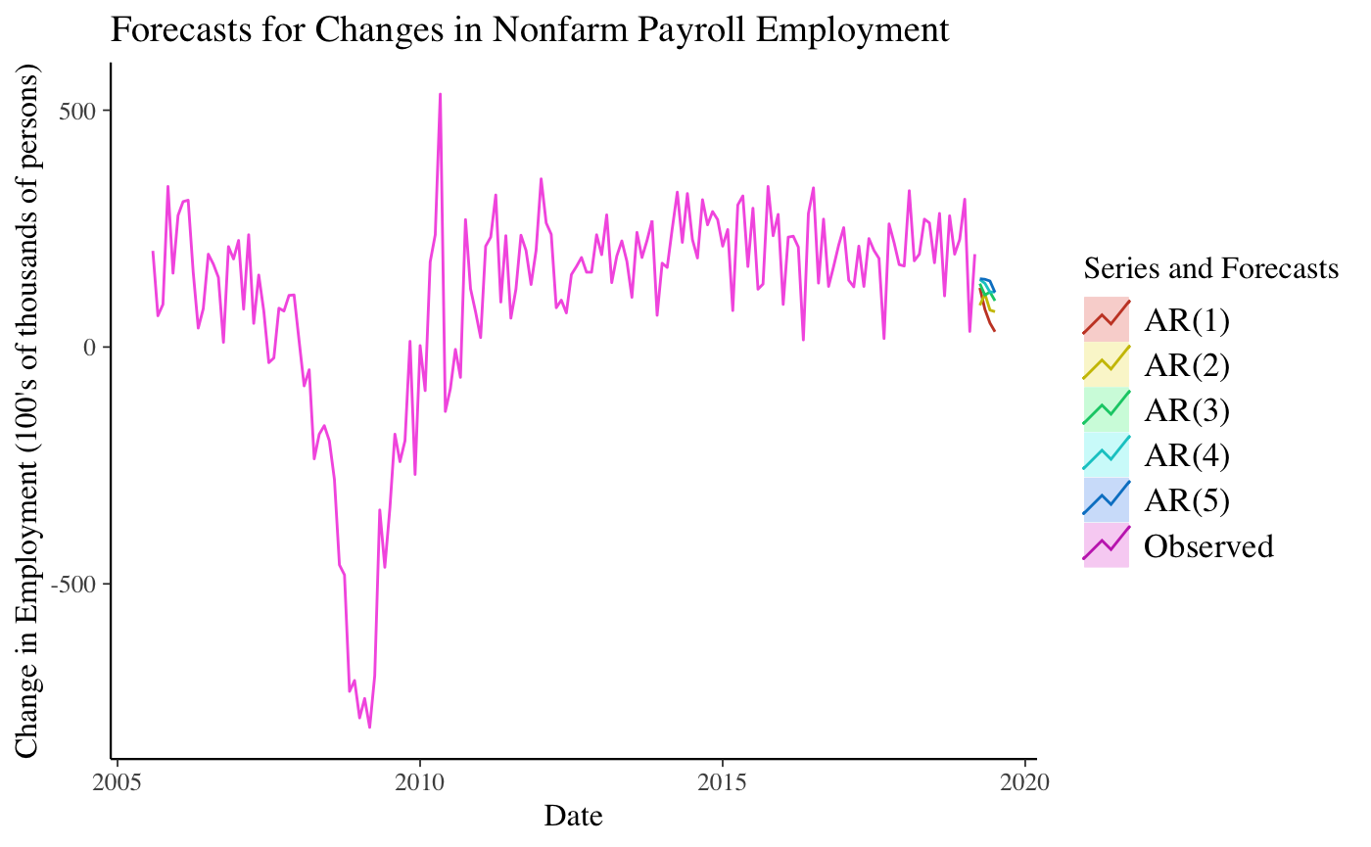
AR(1 – 5) by ERM with respect to Square Loss – Payems

Slide 8
AR(1 – 5) by ERM with respect to Square Loss
Unrate
Method | AR(1) | AR(2) | AR(3) | AR(4) | AR(5)
RMSE | 0.208 | 0.207 | 0.199 | 0.196 | 0.195
AIC | -243.67 | -253.53 | -318.02 | -343.01 | -347.54
Payems
Method | AR(1) | AR(2) | AR(3) | AR(4) | AR(5)
RMSE | 198.1784 | 181.5567 | 177.6057 | 176.6125 | 175.7327
AIC | 12910.92 | 12744.72 | 12704.52 | 12695.78 | 12688.22

Slide 9
VAR(1 – 5) by minimizing additive square loss
Created Vector Autoregressions jointly in unrate, payems, NASDAQ prices, US Retail Gas Prices, CPI, and effective Federal Funds Rate

Slide 10
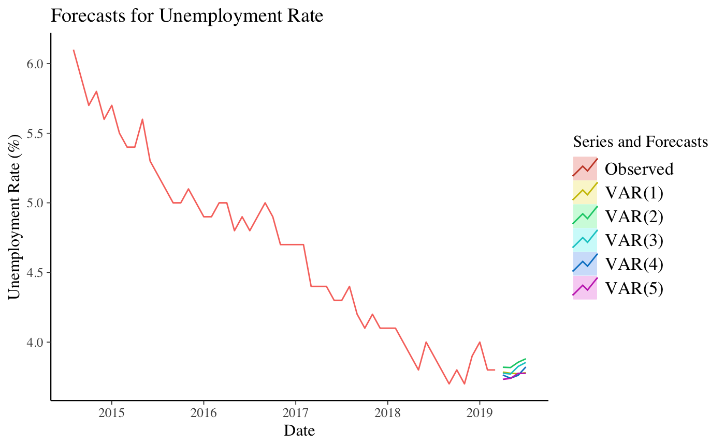
VAR(1 – 5) by minimizing additive square loss – Unrate

Slide 11
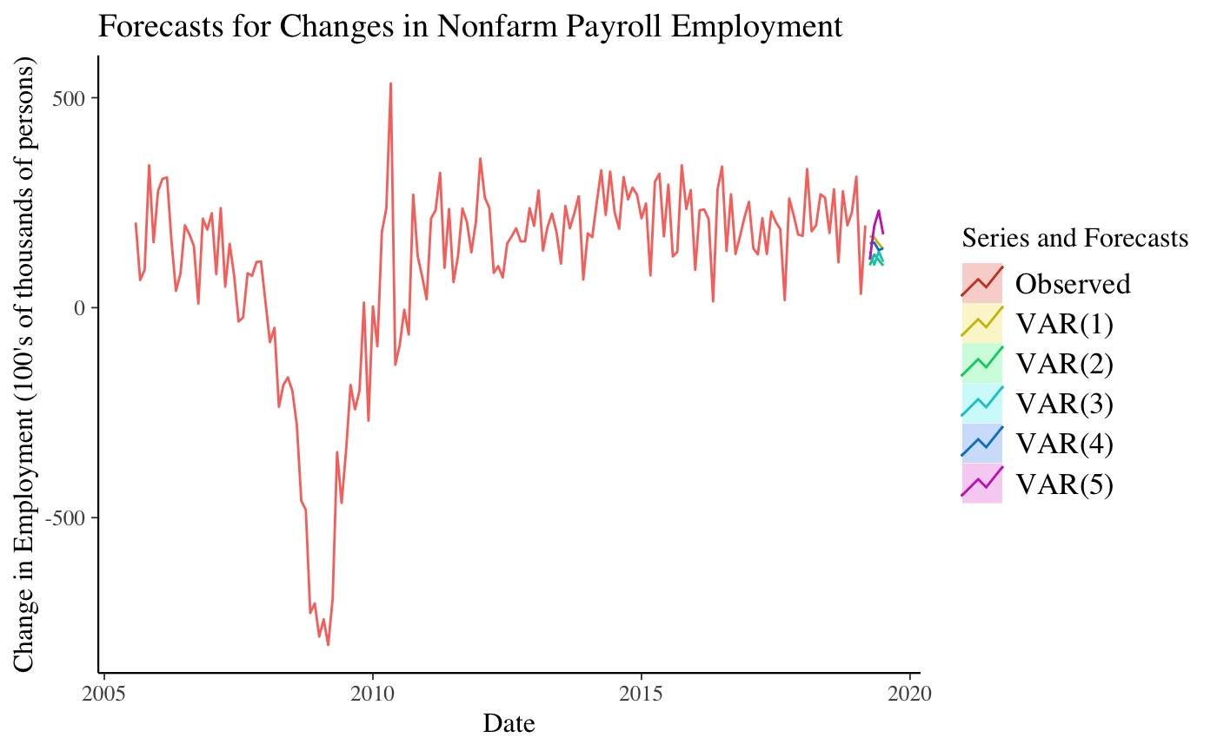
VAR(1 – 5) by minimizing additive square loss – Payems

Slide 12
VAR(1 – 5) by minimizing additive square loss
Method | VAR(1) | VAR(2) | VAR(3) | VAR(4) | VAR(5)
AIC | 5062.369 | 4950.203 | 4925.694 | 4906.418 | 4863.024
BIC | 5205.281 | 5215.259 | 5312.568 | 5414.778 | 5492.54

Slide 13
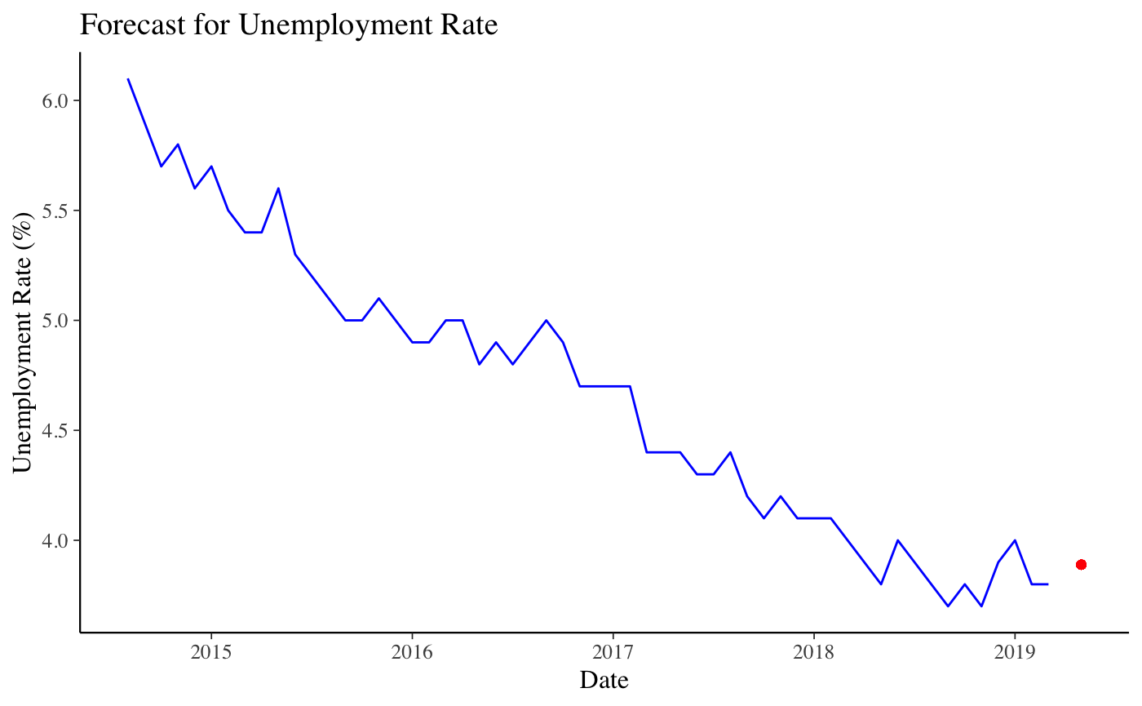
Bayesian: AR(6) with Laplace priors - Unrate

Slide 14
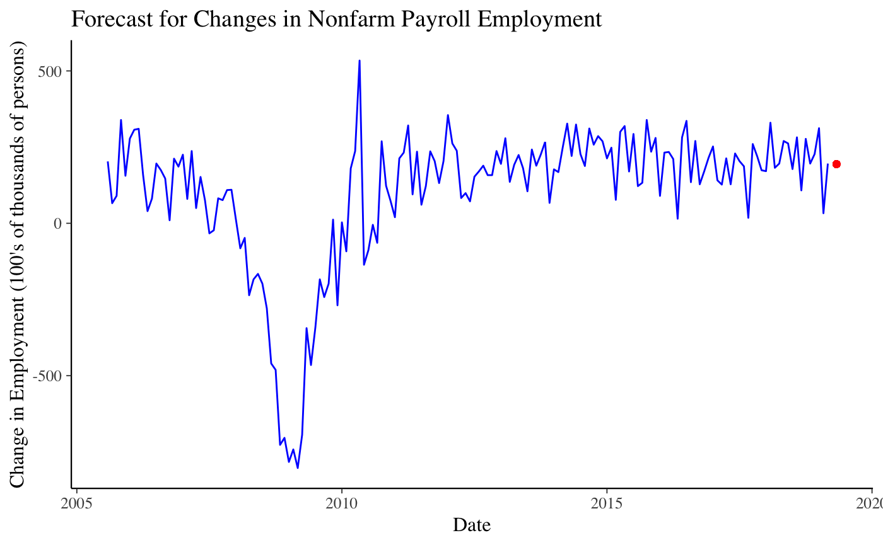
Bayesian: AR(6) with Laplace priors - Payems

Slide 15
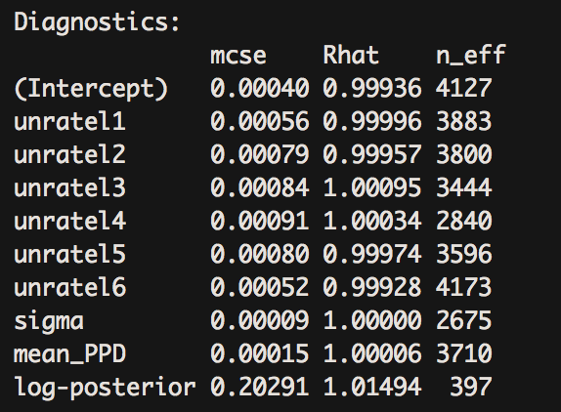
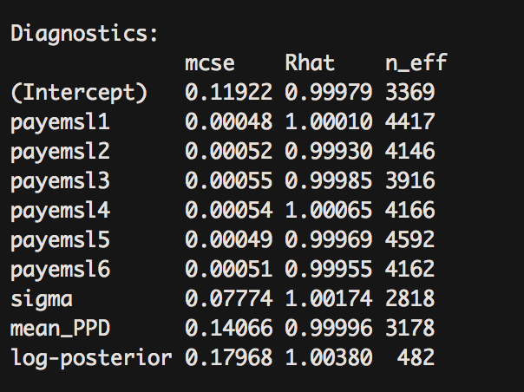
Bayesian: AR(6) with Laplace priors
Unrate
Payems

Slide 16
ML Methods: Tree, Random Forrest, Boost
Created dataset with 11 predictors:
lagged values for unrate/payems (lag1 … lag6)
lag1 values for payems/unrate, NASDAQ prices, US Retail Gas Prices, CPI, and effective Federal Funds Rate

Slide 17

ML Methods: Tree, Random Forrest, Boost - Unrate
Red: Tree
Magenta: Random Forrest
Green: Boosting

Slide 18

ML Methods: Tree, Random Forrest, Boost - Payems
Red: Tree
Magenta: Random Forrest
Green: Boosting

Slide 19
ML Methods: Tree, Random Forrest, Boost
Unrate
Method | Tree | Random Forrest | Boosting
Test RMSE | 0.503 | 0.270 | 0.222
Train RMSE | 0.553 | 0.241 | 0.154
Payems
Method | Tree | Random Forrest | Boosting
Test RMSE | 150.650 | 121.062 | 137.800
Train RMSE | 158.877 | 119.688 | 82.916

Slide 20
Equal-Weighted Averaging for UNRATE
 | Forecast | 25% | 95%
AR(1) | 3.79 | 3.38 | 4.20
AR(2) | 3.79 | 3.38 | 4.20
AR(3) | 3.74 | 3.34 | 4.13
AR(4) | 3.76 | 3.37 | 4.14
AR(5) | 3.78 | 3.39 | 4.16
VAR(1) | 3.78 | 3.52 | 4.04
VAR(2) | 3.81 | 3.56 | 4.06
VAR(3) | 3.77 | 3.52 | 4.02
VAR(4) | 3.76 | 3.51 | 4.01
VAR(5) | 3.73 | 3.48 | 3.97
Bayesian AR(6) w/ Laplace | 3.88 | 3.50 | 4.25
Tree | 4.52
Random Forrest | 3.86
Boost | 3.85
AVERAGE | 3.79%

Slide 21
Equal-Weighted Averaging for PAYEMS
 | Forecast | 25% | 95%
AR(1) | 124.85 | -263.76 | 513.48
AR(2) | 88.02 | -268.18 | 444.24
AR(3) | 133.81 | -214.82 | 482.45
AR(4) | 142.49 | -204.38 | 489.36
AR(5) | 144.12 | -201.20 | 489.45
VAR(1) | 170.51 | -84.40 | 425.43
VAR(2) | 101.02 | -135.49 | 337.54
VAR(3) | 133.24 | -99.33 | 365.81
VAR(4) | 152.97 | -78.346 | 384.29
VAR(5) | 114.50 | -114.67 | 343.68
Bayesian AR(6) w/ Laplace | 194.10 | -154.92 | 540.12
Tree | 146.75
Random Forrest | 213.27
Boost | 246.33
AVERAGE | 170K

